Slide 1



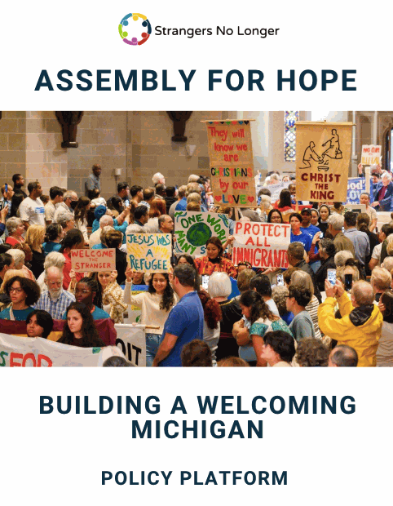
Strangers No Longer Policy Platform Training
Our faith in action
Notes:
Welcome
Name
Staff
Platform - tool for issue awareness and voter information
Please save your questions to the end of the presentation

Slide 2


LEARNING OBJECTIVES
By the end of this training, you will be able to:
  Describe the purpose of Strangers No Longer’s policy platform.
  Name the five Pillars of Belonging.
  Distinguish state-level and federal-level policy proposals.
  Use talking points and personal stories respectfully.
  Identify one action they can take in your community.
Notes:
Our goal is for you to ...

Slide 3
WHO IS
STRANGERS NO LONGER?
Motivated by our faith’s call to compassion and care for the stranger, Strangers No Longer works to promote the inclusion and well-being of immigrants in Michigan.
Our Circles of Support form a statewide network of parishes, high schools, community groups, and local institutions.
﻿
Notes:
A little background

Slide 4
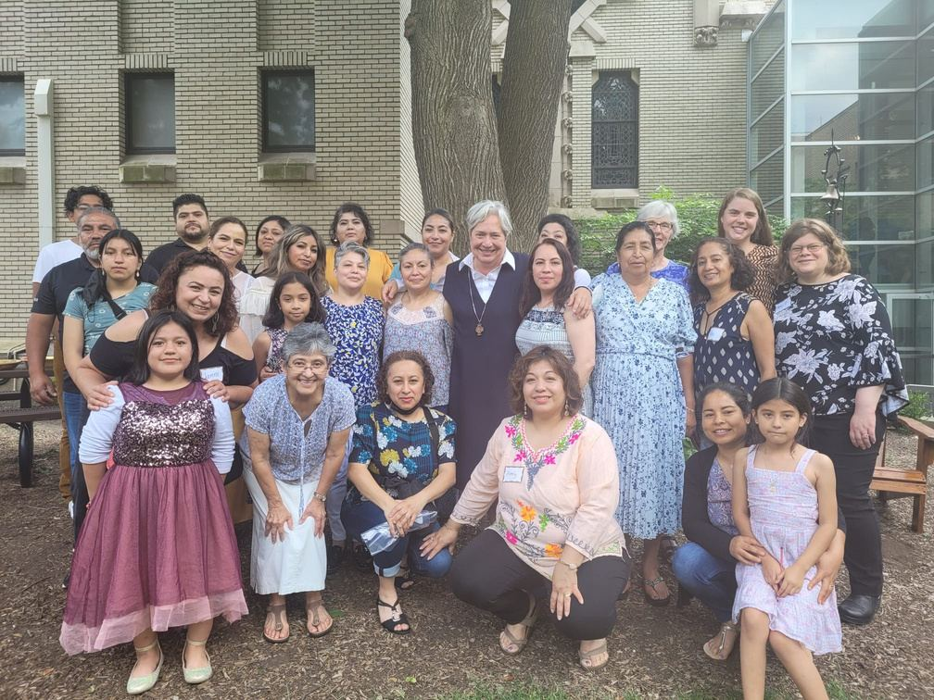
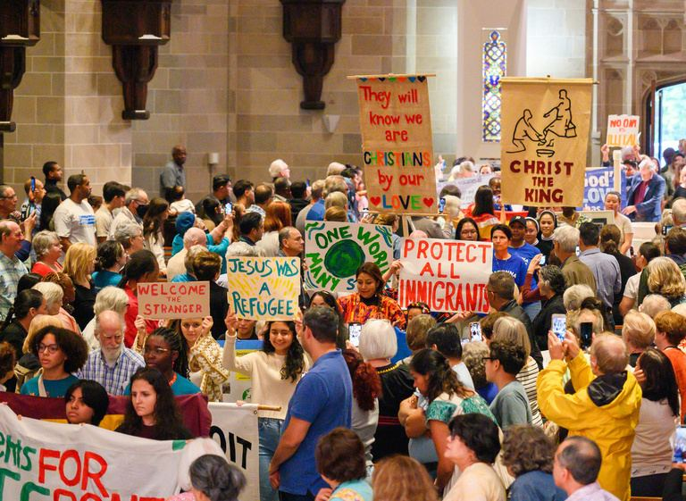
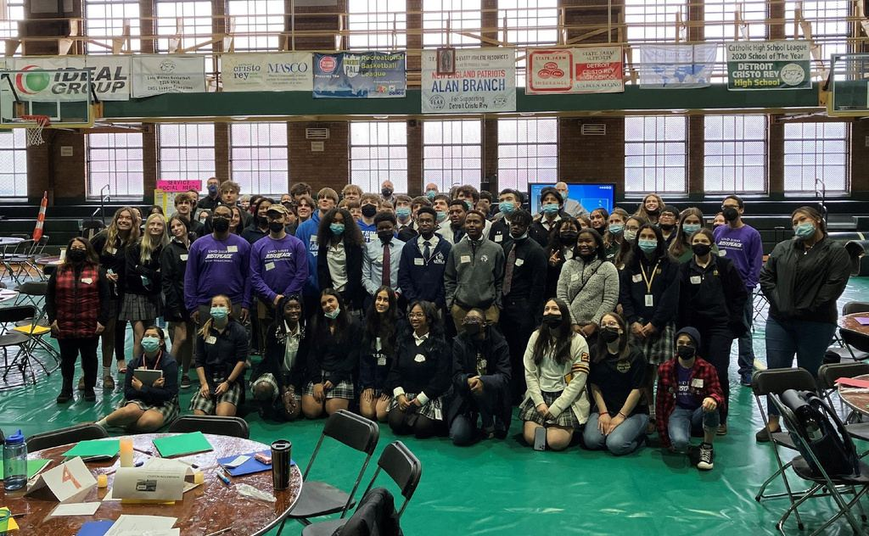
STRANGERS NO LONGER
30+ Anglo/Citizen Circles of Support
10+ Youth Circles of Support
10+ Immigrant Circles of Support

Slide 5

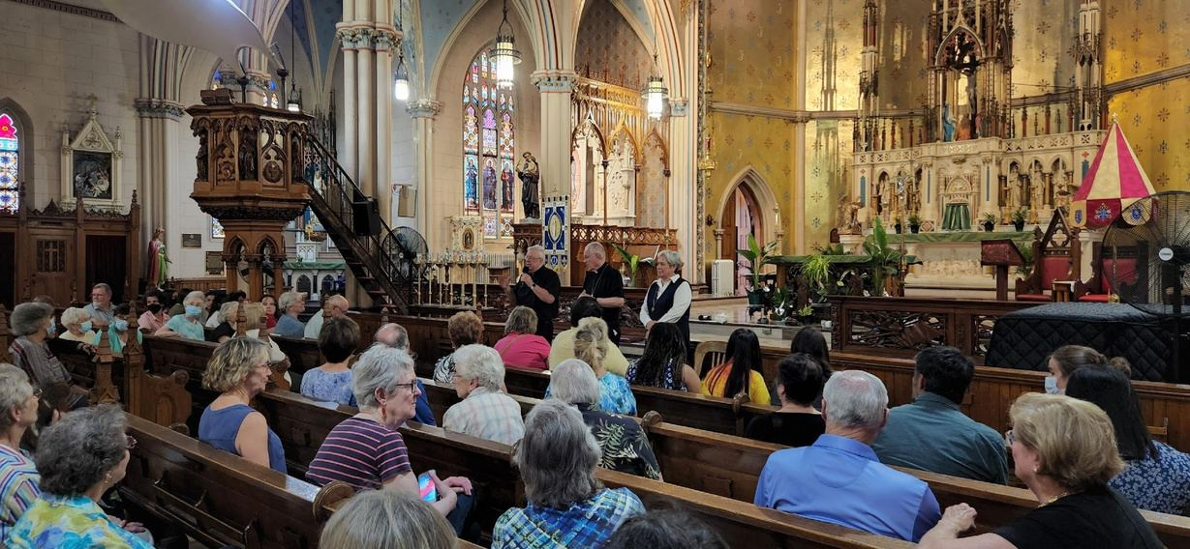
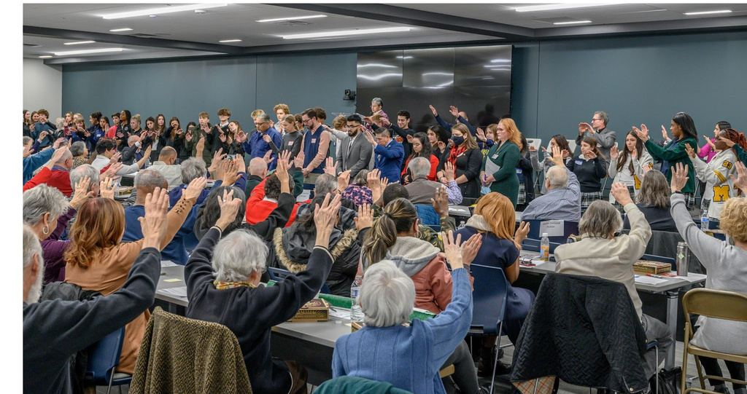
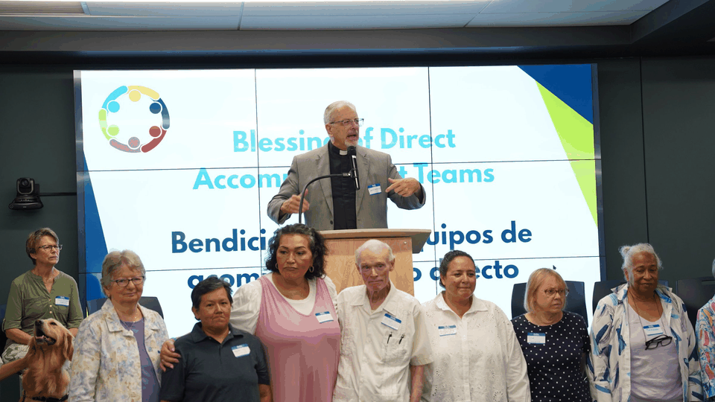
CIRCLE ENGAGEMENT
Education | Accompaniment | Advocacy

Slide 6
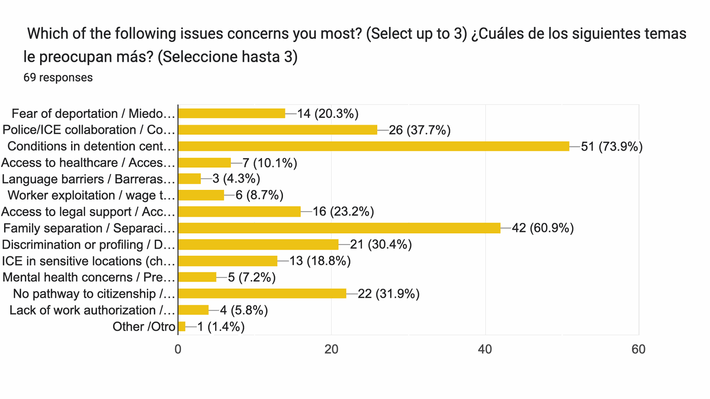
POLICY PLATFORM
Purpose: To put our faith in action by initiating conversations with fellow parishioners but also political candidates and elected officials, regarding the immigration-related issues that matter most to our communities.
Notes:
How did the platform come to be?
What is the purpose of the platform?
- Tool for education
- Tool for issue awareness
- Tool for advocacy

Slide 7
PLATFORM PREAMBLE
Through our direct accompaniment of immigrant communities statewide, we have identified five central themes that unite us as one people. These themes are not simply common ground between U.S-born and foreign-born Americans, but rather a declaration of our shared humanity, rooted in solidarity and the common good. For Michigan to be a welcoming state, the following should hold for all families and residents:
Five Pillars of Belonging for a more Welcoming Michigan:
1. Everyone deserves to live without fear of forcible separation.
2. Everyone deserves safety and protection.
3. Everyone deserves quality community programs and resources.
4. Everyone deserves the opportunity to fully participate in civic and economic life.
5. Everyone deserves the dignity of due process and constitutional protections.
Notes:
Framed the policy platform around not from each of the top five immigration-related concerns
But rather, what a Michigan without these concerns would look like and the values that need to be upheld to make this Michigan possible.
We call these our Five Pillars of Belonging.
1-5

Slide 8
EVERYONE DESERVES TO LIVE WITHOUT FEAR OF FORCIBLE SEPARATION.

Slide 9
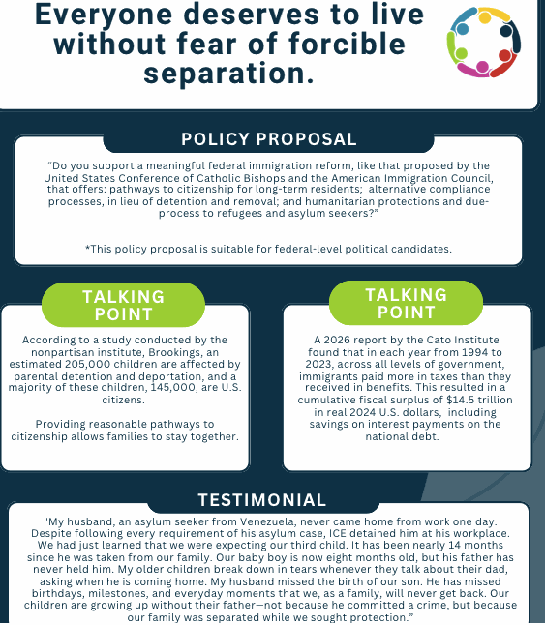
Family separation can affect:
  Parents
  Children
  Extended families
  Schools and neighborhoods
  Community stability
Key Message:
Reasonable pathways to citizenship and humane alternatives to detention are necessary.
Notes:
What is the issue?
- Family separation: testimony and talking points
Grounding ourselves in real experiences from people in our network: the impact of forced separation on a family
Numbers and data are valuable: children and US economy
Why is this an issue?
- Lack of pathways to citizenship
- Detention is the primary mode of enforcement
What is the policy recommendation:
Meaningful immigration reform based on the USCCB and the AIC
This is a federal level ask.

Slide 10
MEANINGFUL FEDERAL IMMIGRATION REFORM
Pathways to citizenship
  Provide long-term residents with a realistic process to develop legal status and citizenship.
  Require applicants to meet clearly defined standards, such as background checks, residence requirements, and other eligibility criteria.
Alternatives to detention and removal
  Create structured compliance options for people with lower-risk immigration cases.
  Use proportionate consequences (e.g., warnings, compliance corrections, or affordable monetary fines) instead of treating detention or deportation as the only enforcement tools.
  Help people understand court dates and immigration requirements so they can comply with the process.
Humanitarian protections
  Provide safe and legal paths to seek protection, ensure humane treatment while cases are pending, & protect people from being returned to unsafe places.
  Expand access to legal help, interpretation, shelter, health care, and other basic services.

Slide 11
MEANINGFUL FEDERAL IMMIGRATION REFORM
Due-process protections
  Guarantee notice of immigration proceedings and the opportunity to present a case.
  Provide access to immigration judges and meaningful appeals.
  Ensure timely bond hearings for people who are detained.
  Improve access to legal counsel and interpreters.
  Establish oversight and accountability for immigration-enforcement agencies.
  Prevent profiling, arbitrary detention, family separation, and removal without a fair hearing.
What this proposal would mean
  It would not eliminate immigration laws or border controls.
  It would not guarantee citizenship to every immigrant automatically.
  It would require clear eligibility standards, background checks, and compliance with the law.
  It would replace overly harsh, one-size-fits-all enforcement with a more fair, proportional, and accountable system.

Slide 12
INTERFAITH PILGRIMAGE:
MEETINGS WITH LEGISLATORS
WHAT PLATFORM-RELEVANT BILLS ARE WE ADVOCATING FOR?

Slide 13
EVERYONE DESERVES SAFETY AND PROTECTION.

Slide 14
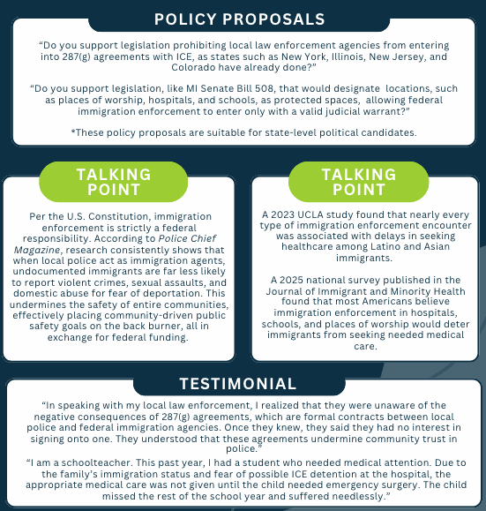
Communities are safer when residents can:
  Report crimes without fear
  Seek emergency medical care
  Worship and attend religious services safely
  Trust local law enforcement
  Receive help regardless of immigration status
Key message:
Immigration enforcement is primarily a federal responsibility.
Local participation can undermine trust in police and make communities less safe.
Notes:
Relates to police and ICE collaboration --heavier reliance on local police to meet interior immigration enforcement quotas
How does it affect?
Fear --> unsafe communities
Why is this an issue?
No clear guidance that emphasizes the fact that immigration enforcement is strictly a federal responsibility per the Constitution.
State ask:
Additionally, this pillar includes the issue related to the protection of sensitive locations (churches, hospitals, schools) from imm. enforcement unless there is a valid judicial warrant.
How does it affect: Health care access of immigrants and their families, including citizen children
Why is this an issue: No longer federally protected spaces (rescinded in the current administration's first day in office)
State ask:

Slide 15
PROHIBITING 287(G) AGREEMENTS
HB 4941 - Prohibits Michigan law enforcement agencies, including state, county, city, village, and township police agencies, from entering into, modifying, or renewing formal immigration-enforcement agreements with federal authorities under Section 287(g) of the Immigration and Nationality Act.
SB 780 - Prohibits Michigan law enforcement agencies from entering into, modifying, or renewing 287(g) agreements with federal immigration authorities. It is the Senate counterpart to HB 4941.
HB 4941 is currently stuck in the House Committee on Government Operations.
SB 780 is currently stuck in the Senate Committee on Government Operations.

Slide 16
PROTECTING SENSITIVE SPACES IN MICHIGAN
Why protected spaces matter
  Children should be able to attend school without fear of immigration arrest.
  Patients should be able to seek medical care without avoiding hospitals.
  People should be able to worship, appear in court, and access victim services safely.
  Service providers can work with families more effectively when residents trust that seeking help will not expose them to immigration enforcement.
  The policy reinforces due process, family stability, and access to essential services.
What the proposal would not do
  It would not make anyone immune from federal immigration law.
  It would not prevent ICE from enforcing federal laws outside protected locations.
  It would not block enforcement when a valid judicial warrant or emergency exception applies.
  It would not stop local police from responding to crimes, emergencies, or threats to public safety.

Slide 17
PROTECTING SENSITIVE SPACES IN MICHIGAN
HB 4859 - Restricts immigration enforcement in sensitive locations. Prohibits immigration enforcement actions in specified locations, including educational institutions, hospitals, places of worship, courthouses, and organizations serving vulnerable populations, subject to court-order and imminent-public-safety exceptions.
SB 508 - Protects sensitive locations from immigration enforcement. Restricts immigration enforcement actions by federal officers in locations such as schools, hospitals, places of worship, courthouses, and certain service organizations, with exceptions including court orders and imminent threats to public safety.
SB 509 - Protects personal information from disclosure for immigration enforcement. Restricts Michigan state agencies and other covered entities from disclosing certain personal information to immigration authorities without a court-issued warrant.
SB 508 is currently ready for the Senate Committee of the Whole to bring up and take a vote.
SB 509 is currently in the Civil Rights, Judiciary and Public Safety Committee.
HB 4859 is currently stuck in the House Committee on Government Operations.

Slide 18
EVERYONE DESERVES QUALITY COMMUNITY PROGRAMS AND RESOURCES.

Slide 19
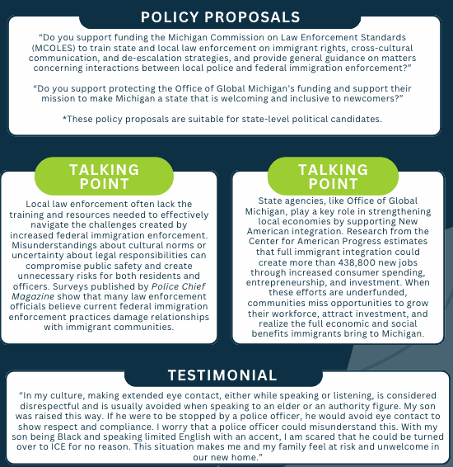
Welcoming communities invest in:
  Cross-cultural communication
  Language access
  Anti-discriminatory trainings
  New American integration
  Community-based support
  Economic opportunity
Key message:
Just and effective public programs help everyone participate and thrive.
Notes:
SNL's Local for Local campaign has revealed several findings
1. Local police need clear guidance when it comes to immigrant rights, cross-cultural interactions, and de-escalation.
2. It isn't just about 287(g) agreements. Collaboration is happening outside of these contracts. Part of the reason is confusion around what their responsibilities are when interacting with federal law enforcement.
This pillar also includes protecting OGM, an office that is supporting immigrants and refugees in critical ways, including workforce development and other inclusion in the community efforts.
State ask:

Slide 20
TRAINING MICHIGAN LAW ENFORCEMENT ON IMMIGRANT RIGHTS
Role of MCOLES
  MCOLES establishes statewide standards for the recruitment, training, licensing, and continuing education of Michigan law-enforcement officers.
  State funding would allow MCOLES to develop consistent training and guidance for state and local agencies.
Core training areas
  Immigrant rights
    Constitutional protections
    Rights during traffic stops, questioning, searches, and detention
    Limits on local police involvement in federal civil immigration enforcement
    Distinction between criminal investigations and immigration matters
    Appropriate use of interpreters and language-access services
Notes:
Michigan Commission on Law Enforcement Standards - MCOLES

Slide 21
TRAINING MICHIGAN LAW ENFORCEMENT ON IMMIGRANT RIGHTS
  De-escalation
    Techniques for reducing fear, confusion, and conflict
    Trauma-informed responses for refugees and survivors of violence
    Safer approaches during encounters involving language barriers or cultural misunderstandings
  Guidance on federal immigration enforcement
    Explain the difference between a judicial warrant and an administrative immigration document.
    Clarify agency procedures for:
      Requests for information
      Detainers and custody transfers
      Immigration enforcement near schools, hospitals, courts, and places of worship
    Emphasize that local police should focus on state and local public safety responsibilities.
Notes:
Elaborate on distinction between criminal investigations and immigration matters

Slide 22
TRAINING MICHIGAN LAW ENFORCEMENT ON IMMIGRANT RIGHTS
HB 5495 - Prohibits stops, detentions or arrests based solely on personal characteristics, including assumptions about immigration status. Requires federal officers to follow constitutional protections when enforcing state law in Michigan and denies them special legal protections if they violate those rights. Reiterate that officers may not forcibly enter anybody’s homes without a judicial warrant, consistent with core Fourth Amendment principles and long-standing constitutional protections.
SB 334 - Requires law-enforcement training in de-escalation, implicit bias, procedural justice, crisis intervention, and behavioral health. The bill establishes training standards through the Michigan Commission on Law Enforcement Standards (MCOLES), requires training for new and existing officers, and addresses agency policies for de-escalation. It is tied to SB 341.
SB 341 - Strengthens law-enforcement officer licensing and accountability requirements.
HB 5495 is currently stuck in the House Committee on Government Operations.
SB 334 was referred to the Committee of the Whole on September 9, 2025. This bill is tie-barred
with SB 341, which relates to background checks for police candidates.
Notes:
Elaborate on distinction between criminal investigations and immigration matters

Slide 23
EVERYONE DESERVES THE OPPORTUNITY TO FULLY PARTICIPATE IN CIVIC AND ECONOMIC LIFE.

Slide 24
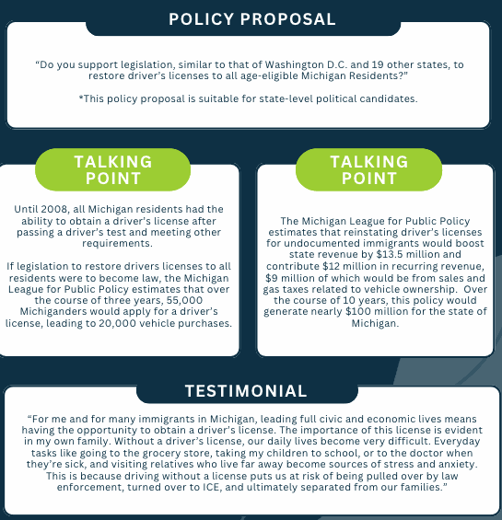
Full civic and economic participation includes the ability to:
  Drive legally
  Take children to school
  Reach medical care
  Work and support a family
  Access education and services
  Contribute to local economies
Key Message:
Our state’s safety and economy will benefit from the restoration of driver’s licenses for all.
Notes:
How it affects:
- Working
- School
- Medical
- Continuous state of fear
Why is this happening?
- Law change in 2008
Why (else) does it need to change?
- Economic point: MLPP estimates a $13.5M boost in state revenue and $12M in recurring revenue
State ask:

Slide 25
MICHIGAN DRIVER’S LICENSES FOR ALL AGE-ELIGIBLE RESIDENTS
Policy history
  Michigan added a “legal presence” requirement in 2008.
  This change prevented undocumented immigrants from obtaining standard driver’s licenses or state IDs. It also created difficulties for some citizens and lawfully present immigrants whose documents were missing, delayed, or difficult to verify.
  Previously, eligibility was generally based on identity, Michigan residency, testing, and safety requirements.
Who can currently obtain a license?
  Permanent residents
  Refugees and asylees
  People with valid visas or other recognized immigration protections
  Applicants who meet Michigan’s identity, residency, vision, knowledge, and road-test requirements
Notes:
In 1995, Democratic Attorney General Frank Kelley gave everyone access to licenses as long as they could pass a driving test and prove they lived in the state.
In 2007, Republican Attorney General Mike Cox issued an opinion that reversed Kelley’s decision, citing implications for state and national security and the potential for fraud.

Slide 26
MICHIGAN DRIVER’S LICENSES FOR ALL AGE-ELIGIBLE RESIDENTS
What the proposed policy would do
  Restore access to standard Michigan licenses for all age-eligible residents.
  Require the same identity, residency, testing, and safety standards for everyone.
  Allow all residents to obtain insurance and register vehicles.
  Improve access to employment, education, health care, and essential services.
  Promote safer roads and stronger, more stable communities.
What the policy would NOT do
  Grant immigration status or citizenship
  Create voting eligibility
  Automatically provide a REAL ID
  Eliminate driving tests or safety requirements
Notes:
What this proposal would do:
Stop the funneling of immigrants into the detention and deportation pipeline

Slide 27
MICHIGAN DRIVER’S LICENSES FOR ALL AGE-ELIGIBLE RESIDENTS
HB 4195 - Removes citizenship and legal-presence requirements for obtaining a Michigan driver’s license. Amends the Michigan Vehicle Code so that immigration status would not determine residency for licensing purposes. The bill also restricts the use of certain Secretary of State records for immigration enforcement. Applicants would still need to meet applicable licensing and safety requirements.
HB 4195 was defeated on the floor with a vote of 39–64 in March 2025, with six Democrats joining the Republican majority to vote against it.
Notes:
What this proposal would do:
Stop the funneling of immigrants into the detention and deportation pipeline

Slide 28
EVERYONE DESERVES THE DIGNITY OF DUE PROCESS AND CONSTITUTIONAL PROTECTIONS.

Slide 29
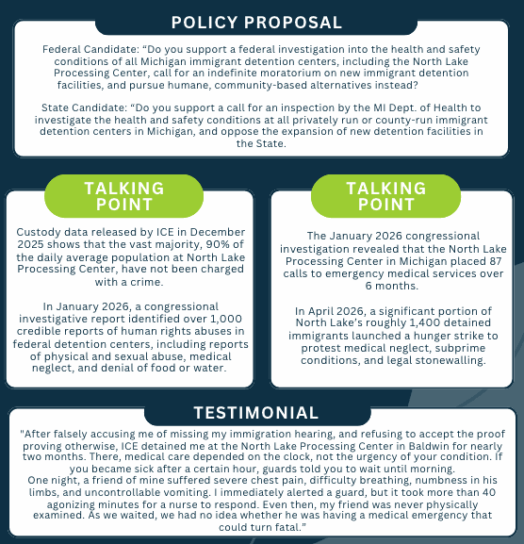
Due process includes:
  Access to legal information
  A fair opportunity to present one’s case
  Humane conditions
  Timely medical care
  Protection from abuse and neglect
  Accountability in detention facilities
Key Message:
Due process is a Constitutional right for all residing in our country, regardless of their immigration status.
Notes:
Horrid stories from people in detention, incl. medical neglect and human rights abuses
Federal ask:
State ask:

Slide 30
HEALTH AND SAFETY OVERSIGHT OF IMMIGRANT DETENTION FACILITIES
Proposed state inspection
  Direct the Michigan Department of Health and Human Services (MDHHS) to inspect all privately operated and county-run facilities that house people for federal immigration purposes.
  Review conditions regularly, not only after a complaint or emergency.
  Make inspection findings and corrective-action plans available to the public.
  Establish a process for detained people, families, staff, attorneys, and advocates to submit confidential complaints.
Areas inspectors should examine (not limited to)
  Access to timely medical, dental, and mental-health care
  Food quality, drinking water, sanitation, heating, ventilation, fire safety, and personal hygiene
  Use of solitary confinement and restraints
  Protection from abuse, harassment, and retaliation
  Access to telephones, legal counsel, interpreters, visitation, and religious services
  Conditions for people with disabilities, pregnant people, older adults, and LGBTQ+ detainees
  Procedures for suicide prevention, infectious-disease control, and medical emergencies
Notes:
No bills yet.

Slide 31
HEALTH AND SAFETY OVERSIGHT OF IMMIGRANT DETENTION FACILITIES
Accountability measures
  Impose consequences for repeated or serious violations, including financial penalties or loss of state authorization to operate.
  Require public reporting on inspections, complaints, deaths, serious injuries, medical emergencies, and corrective actions.
  Protect whistleblowers and prohibit retaliation against those who report unsafe conditions.
  Coordinate with appropriate federal oversight agencies while maintaining independent state review.
Opposition to new detention facilities
  Oppose the construction, expansion, or conversion of additional Michigan facilities for immigrant detention.
  Require public notice, hearings, and legislative review before any new detention contract or facility expansion.
  Prevent state or local tax dollars, land, personnel, or infrastructure from subsidizing new federal detention capacity.
Notes:
Romulus detention center

Slide 32
HEALTH AND SAFETY OVERSIGHT OF IMMIGRANT DETENTION FACILITIES
HB 5494 - Prohibits the transfer of Michigan state-owned property to ICE for immigration detention purposes. The bill would prohibit the state from selling or transferring property to U.S. Immigration and Customs Enforcement (ICE) or its subsidiaries and restrict transferred property from being used as an immigration detention center. It also provides for the state to reclaim property if the restrictions are violated.
HB 5494 was introduced on January 29, 2026, and referred to the House Committee on Government Operations.
Notes:
Romulus detention center

Slide 33
CONSIDERATIONS
  Our meetings and asks will primarily depend on whom we meet with and whether they will be returning in January for the next legislative session.
  No current bill means that we will advocate for the introduction of new legislation.
  Meeting with legislators is ideal, but some may meet with staff instead. This is still valuable.
  We will prioritize constituents meeting with their own elected officials.
  Advocates/Policy Captains can expect contact sheets, schedules, and scripts.
Notes:
Romulus detention center

Slide 34

TAKE ACTION
Join our Interfaith Pilgrimage for a Welcoming Michigan
  Share the Policy Platform with your community networks
  Present the Policy Platform to elected officials/political candidates

Slide 35


SIGN UP FOR SNL’S NEWSLETTER
For more information, please contact Odalis Perales:
perales.o@strangersnolonger.org

Slide 36
CLOSING REFLECTIONS
  Complete this sentence:
“A welcoming Michigan is a place where ______________________.”
  Share out:
    One value you want to carry forward
    One policy you want to learn more about
    One action you will take

